Slide 1
My future term paper
Murzabekov Almaz
HSE, 12.2019

Slide 2
Project analysis slide 2
Area of research
MACHINE LEARNING
DATA ENGINEERING
SOFTWARE ENGINEERING
DATA VISUALIZATION
DATA ANALISYS/ MINING
COMPUTER VISION

Slide 3
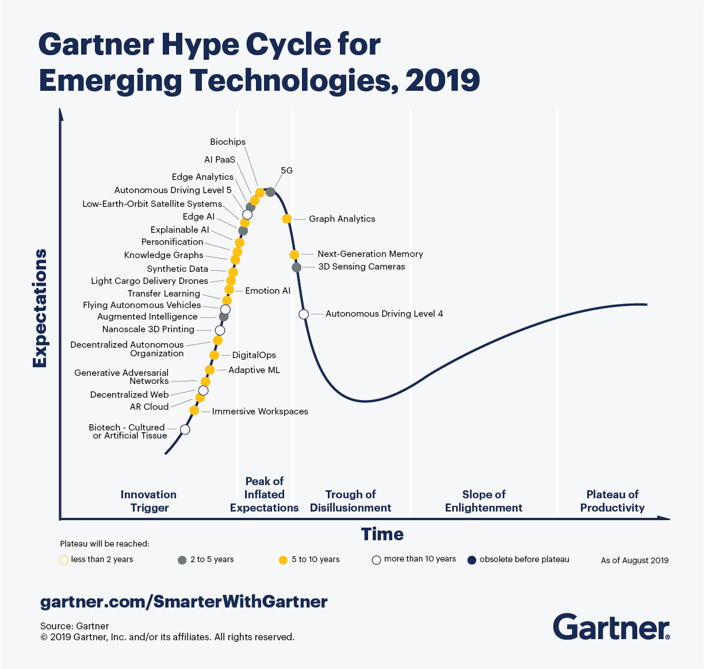
Project analysis slide 5
Self-driving cars

Slide 4
Project analysis slide 6
Term-paper topic
Topic: ”An Intelligent System For Perceiving Self-Driving Car (SDC) Surroundings”
Content
Background
”State of the art” - SDC
Project: Russian traffic sign detection
Project: Russian traffic light detection
Project: Traffic pedestrian detection
Supervisors
Ismail Kayali
Yevgeni Koucheryavy

Slide 5
Thank You

